Slide 1
Object-Oriented Systems
Analysis and Design Using UML
(Class Diagram)
Systems Analysis and Design
Course Code: CSE 305
Spring 2022 Semester

Slide 2
Class Diagrams
In software engineering, a class diagram in the Unified Modeling Language (UML) is a type of static structure diagram that describes the structure of a system by showing the system's classes, their attributes, operations (or methods), and the relationships among objects.
A class diagram is a type of UML diagram that describes a system by visualizing the different types of objects within a system and the kinds of static relationships that exist among them. It also illustrates the operations and attributes of the classes.
18-<number>

Slide 3
Purpose of Class Diagrams
The purpose of the class diagram can be summarized as −
Analysis and design of the static view of an application.
Describe responsibilities of a system.
18-<number>

Slide 4
Benefits of Class Diagrams
It can represent the object model for complex systems.
It reduces the maintenance time by providing an overview of how an application is structured before coding.
It provides a general schematic of an application for better understanding.
It is helpful for the stakeholders and the developers.
18-<number>

Slide 5
Vital components of a Class Diagram
The class diagram is made up of three sections:
Upper Section: The upper section encompasses the name of the class. A class is a representation of similar objects that shares the same relationships, attributes, operations, and semantics. Some of the following rules that should be taken into account while representing a class are given below:
  Capitalize the initial letter of the class name.
  Place the class name in the center of the upper section.
  A class name must be written in bold format.
  The name of the abstract class should be written in italics format.
18-<number>

Slide 6
Vital components of a Class Diagram
Middle Section: The middle section constitutes the attributes, which describe the quality of the class. The attributes have the following characteristics:
  The attributes are written along with its visibility factors, which are public (+), private (-), protected (#), and package (~).
  A meaningful name should be assigned to the attribute, which will explain its usage inside the class.
18-<number>

Slide 7
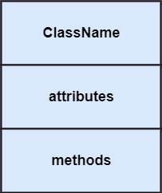
Vital components of a Class Diagram
Lower Section: The lower section contain methods or operations. The methods are represented in the form of a list, where each method is written in a single line. It demonstrates how a class interacts with data.
18-<number>

Slide 8
Classes
A class is a description of a set of
objects that share the same attributes,
operations, relationships, and semantics.
Graphically, a class is rendered as a
rectangle, usually including its name,
attributes, and operations in separate,
designated compartments.
ClassName
attributes
operations
Software Design (UML)

Slide 9
Class Names
ClassName
The name of the class is the only required tag in the graphical representation of a class. It always appears in the top-most compartment.
attributes
operations
Software Design (UML)

Slide 10
Class Attributes
Person
name : String
address : Address
birthdate : Date
ssn : Id
An attribute is a named property of a
class that describes the object being modeled.
In the class diagram, attributes appear in
the second compartment just below the
name-compartment.
Software Design (UML)

Slide 11
Class Attributes (Cont’d)
Attributes are usually listed in the form:
attributeName : Type
A derived attribute is one that can be
computed from other attributes, but
doesn’t actually exist. For example,
a Person’s age can be computed from
his birth date. A derived attribute is
designated by a preceding ‘/’ as in:
/ age : Date
Person
name : String
address : Address
birthdate : Date
/ age : Date
ssn : Id
Software Design (UML)

Slide 12
Class Attributes (Cont’d)
Person
+ name : String
# address : Address
# birthdate : Date
/ age : Date
- ssn : Id
Attributes can be:
+ public
# protected
- private
/ derived
Software Design (UML)

Slide 13
Class Operations
Person
name : String
address : Address
birthdate : Date
ssn : Id
eat
sleep
work
play
Operations describe the class behavior
and appear in the third compartment.
Software Design (UML)

Slide 14
Class Responsibilities
A class may also include its responsibilities in a class diagram.
A responsibility is a contract or obligation of a class to perform a particular service.
SmokeAlarm
Responsibilities
-- sound alert and notify guard station
when smoke is detected.
-- indicate battery state
Software Design (UML)

Slide 15
Class Responsibilities
A class may also include its responsibilities in a class diagram.
A responsibility is a contract or obligation of a class to perform a particular service.
SmokeAlarm
Responsibilities
-- sound alert and notify guard station
when smoke is detected.
-- indicate battery state
Software Design (UML)

Slide 16
Relationships
In UML, object interconnections (logical or physical), are
modeled as relationships.
There are three kinds of relationships in UML:
  dependencies
  generalizations
  associations
Software Design (UML)

Slide 17
Dependency Relationships
A dependency indicates a semantic relationship between two or
more elements. The dependency from CourseSchedule to Course exists because Course is used in both the add and remove operations of CourseSchedule.
CourseSchedule
Course
add(c : Course)
remove(c : Course)
Software Design (UML)

Slide 18

Dependency Relationships
Dependency: A dependency is a semantic relationship between two or more classes where a change in one class cause changes in another class. It forms a weaker relationship.
In the following example, Student_Name is dependent on the Student_Id.
Dependency: A dependency is a semantic relationship between two or more classes where a change in one class cause changes in another class. It forms a weaker relationship.
In the following example, Student_Name is dependent on the Student_Id.

Slide 19
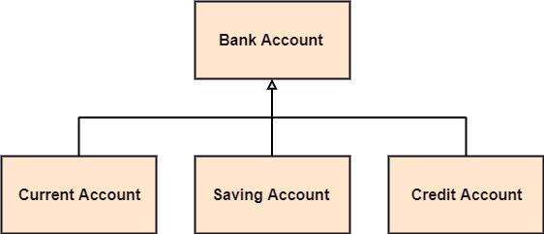
Generalization Relationships
Generalization: A generalization is a relationship between a parent class (superclass) and a child class (subclass). In this, the child class is inherited from the parent class.
For example, The Current Account, Saving Account, and Credit Account are the generalized form of Bank Account.

Slide 20
Generalization Relationships
Person
A generalization connects a subclass
to its superclass. It denotes an
inheritance of attributes and behavior
from the superclass to the subclass and
indicates a specialization in the subclass
of the more general superclass.
Student
Software Design (UML)

Slide 21
Generalization Relationships (Cont’d)
UML permits a class to inherit from multiple superclasses, although some programming languages (e.g., Java) do not permit multiple inheritance.
Student
Employee
TeachingAssistant
Software Design (UML)

Slide 22

Association Relationships
Association: It describes a static or physical connection between two or more objects. It depicts how many objects are there in the relationship.
For example, a department is associated with the college.
Software Design (UML)

Slide 23
Association Relationships
If two classes in a model need to communicate with each other, there must be link between them.
An association denotes that link.
Student
Instructor
Software Design (UML)

Slide 24
Association Relationships (Cont’d)
We can indicate the multiplicity of an association by adding multiplicity adornments to the line denoting the association.
The example indicates that a Student has one or more Instructors:
Student
Instructor
1..*
Software Design (UML)

Slide 25
Association Relationships (Cont’d)
The example indicates that every Instructor has one or more Students:
Student
Instructor
1..*
Software Design (UML)

Slide 26
Association Relationships (Cont’d)
We can also indicate the behavior of an object in an association (i.e., the role of an object) using rolenames.
teaches
learns from
Student
Instructor
1..*
1..*
Software Design (UML)

Slide 27
Association Relationships (Cont’d)
We can also name the association.
membership
Student
Team
1..*
1..*
Software Design (UML)

Slide 28
Association Relationships (Cont’d)
We can specify dual associations.
member of
Student
Team
1..*
1..*
1
president of
1..*
Software Design (UML)

Slide 29
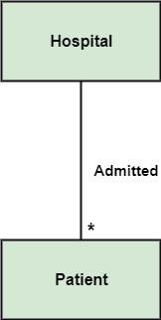
Multiplicity
Multiplicity: It defines a specific range of allowable instances of attributes. In case if a range is not specified, one is considered as a default multiplicity.
For example, multiple patients are admitted to one hospital.
18-<number>

Slide 30
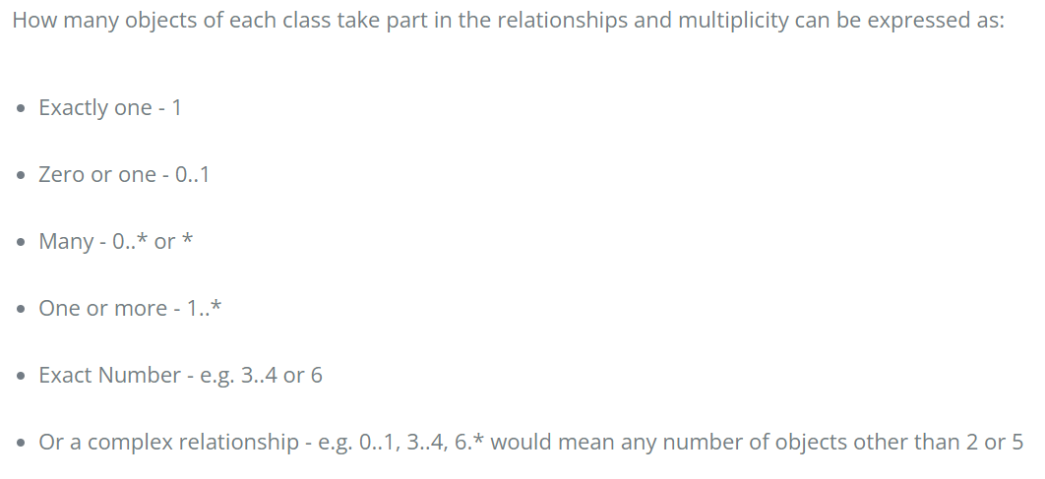
Multiplicity
18-<number>

Slide 31

Aggregation
Aggregation: An aggregation is a subset of association, which represents has a relationship. It is more specific then association. It defines a part-whole or part-of relationship. In this kind of relationship, the child class can exist independently of its parent class.
The company encompasses a number of employees, and even if one employee resigns, the company still exists.
18-<number>

Slide 32

Composition
Composition: The composition is a subset of aggregation. It portrays the dependency between the parent and its child, which means if one part is deleted, then the other part also gets discarded. It represents a whole-part relationship.
A contact book consists of multiple contacts, and if you delete the contact book, all the contacts will be lost.
18-<number>

Slide 33
How to Draw a Class Diagram?
The following points should be remembered while drawing a class diagram −
The name of the class diagram should be meaningful to describe the aspect of the system.
Each element and their relationships should be identified in advance.
Responsibility (attributes and methods) of each class should be clearly identified
For each class, minimum number of properties should be specified, as unnecessary properties will make the diagram complicated.
Use notes whenever required to describe some aspect of the diagram. At the end of the drawing it should be understandable to the developer/coder.
Finally, before making the final version, the diagram should be drawn on plain paper and reworked as many times as possible to make it correct.
18-<number>

Slide 34
How to Draw a Class Diagram?
Step 1: Identify the class names
The first step is to identify the primary objects of the system.
Step 2: Distinguish relationships
Next step is to determine how each of the classes or objects are related to one another.
Step 3: Create the Structure
First, add the class names and link them with the appropriate connectors. You can add attributes and functions/ methods/ operations later.
18-<number>

Slide 35
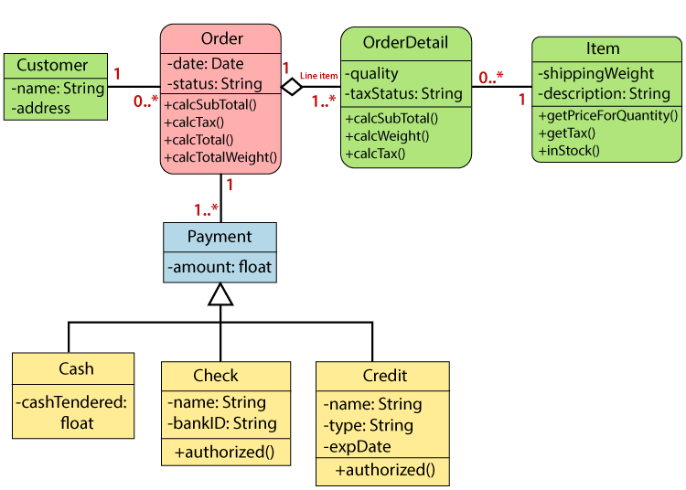
Class Diagrams example
A class diagram describing the sales order system is given below.
18-<number>

Slide 36
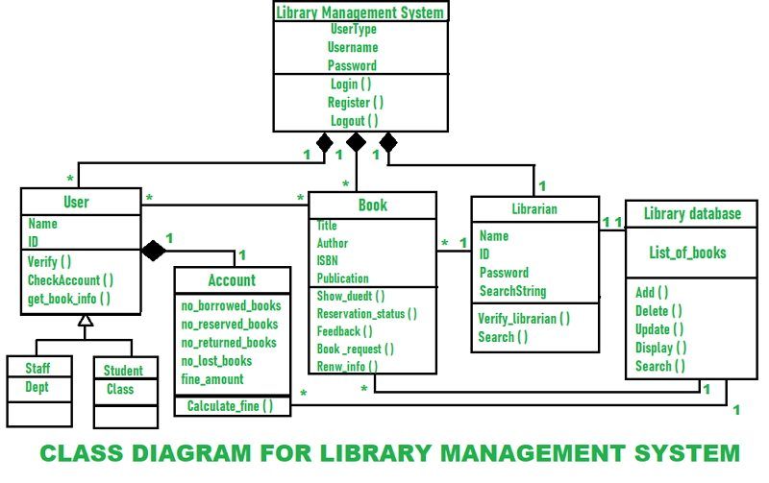
Class Diagrams example
A class diagram describing the library management system is given below.
18-<number>

Slide 37
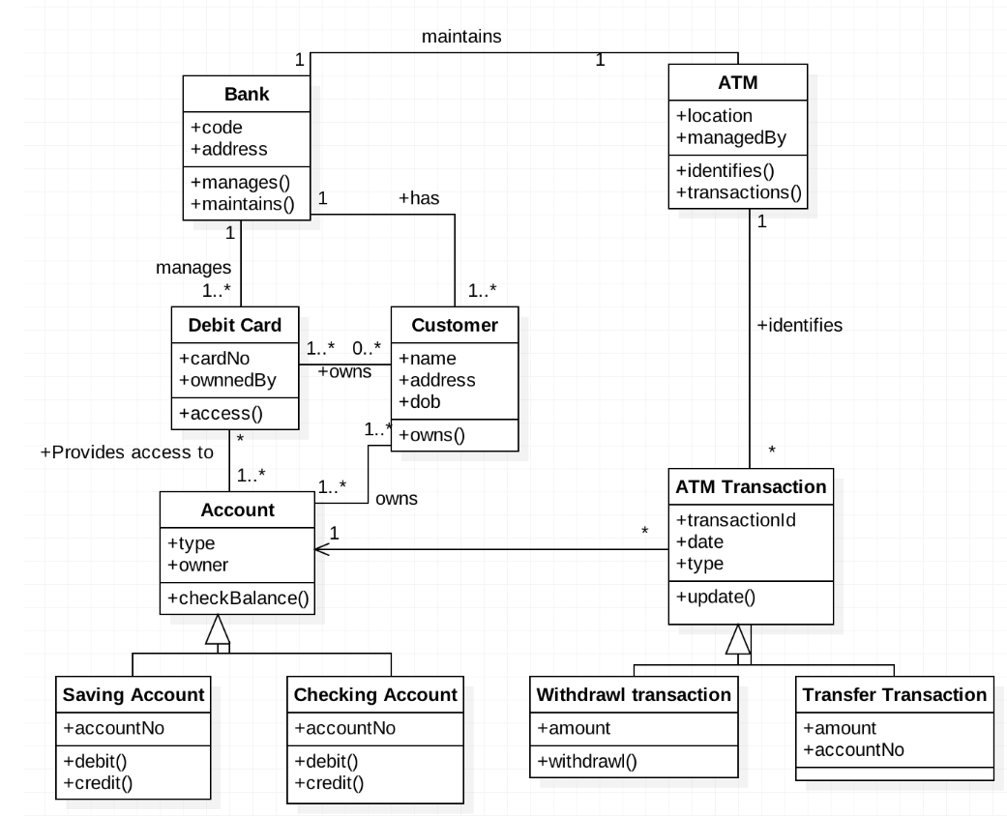
Class Diagrams example
A class diagram describing the Account & ATM system is given below.
18-<number>

